Slide 1
Using Behavioural Approaches in Organizational Change Management: Lessons and Opportunities for the UN System
05 February 2019
Joint Inspection Unit of the United Nations System
Geneva, Switzerland
Lori Foster, Ph.D.
Professor of Psychology
North Carolina State University, USA
University of Cape Town, South Africa

Slide 2
Reform
Change Management
Culture

Slide 3
“Working Differently Together”
“Shifting The Culture”
“Be The Change”

Slide 4
I-O Psychology
Behavioral
Economics

Slide 5
Behavioral
Economics

Slide 6
Behavioural Insights
Lessons derived from the behavioural and social sciences, including decision making, psychology, cognitive science, neuroscience, organisational and group behaviour (OECD, 2017).

Slide 8
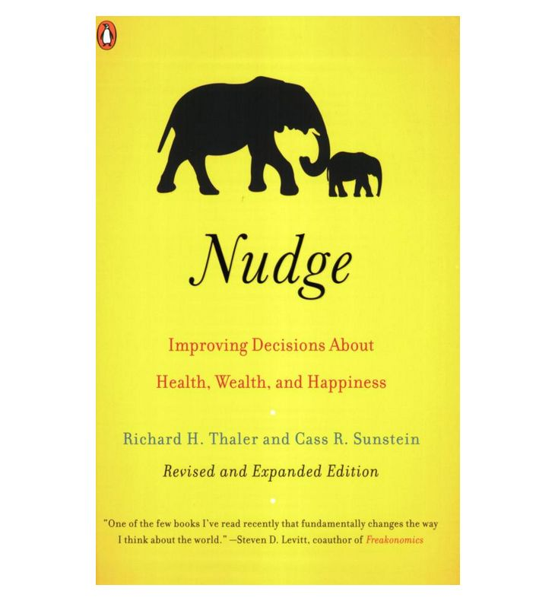
Behavioral Insights

Slide 9
Homo Economicus
Homo Sapien

Slide 11
People may want to:
attend a training
use a new technology
comply with a new procedure
provide regular performance feedback
etc.
…but may fail to follow through on their intentions for a variety of reasons.
Notes:
Research has evaluated several different types of interventions designed to help individuals carry out the intentions they themselves have, many of which have been or could be fruitfully incorporated into public policy.

Slide 12
Overconfidence
Present Bias
Loss Aversion
Status Quo Bias
Inattention
Temptation
Procrastination
Hassle Factors
Inertia

Slide 13
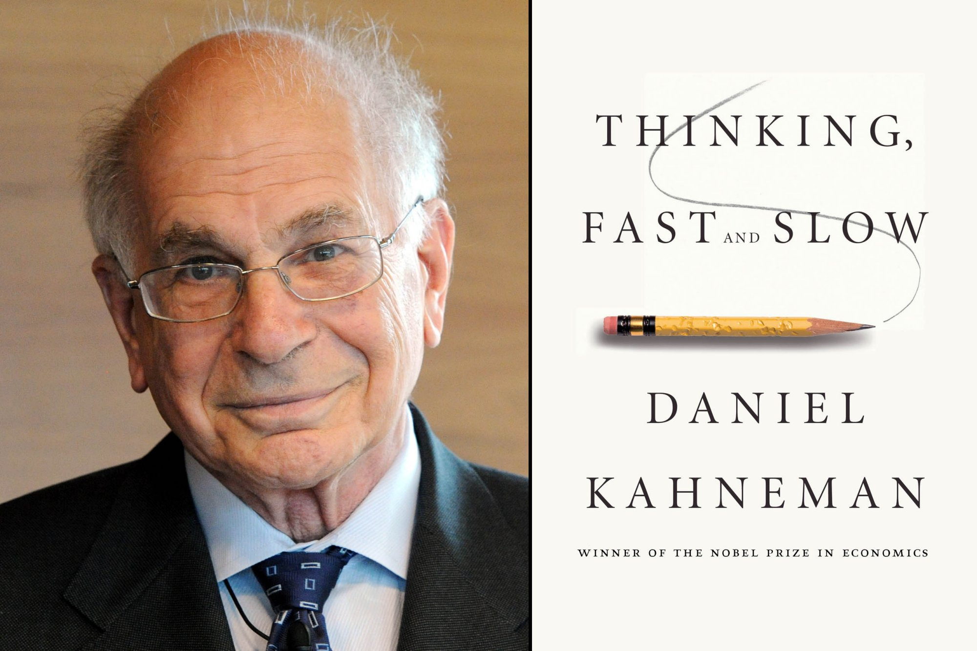
2002
Notes:
https://www.nytimes.com/2016/12/06/books/review/michael-lewis-undoing-project.html
Michael Lewis (Moneyball), book The Undoing Project

Slide 14
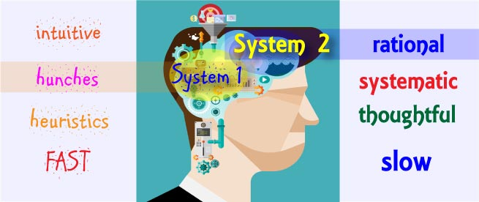
“Predictably Irrational”

Slide 16
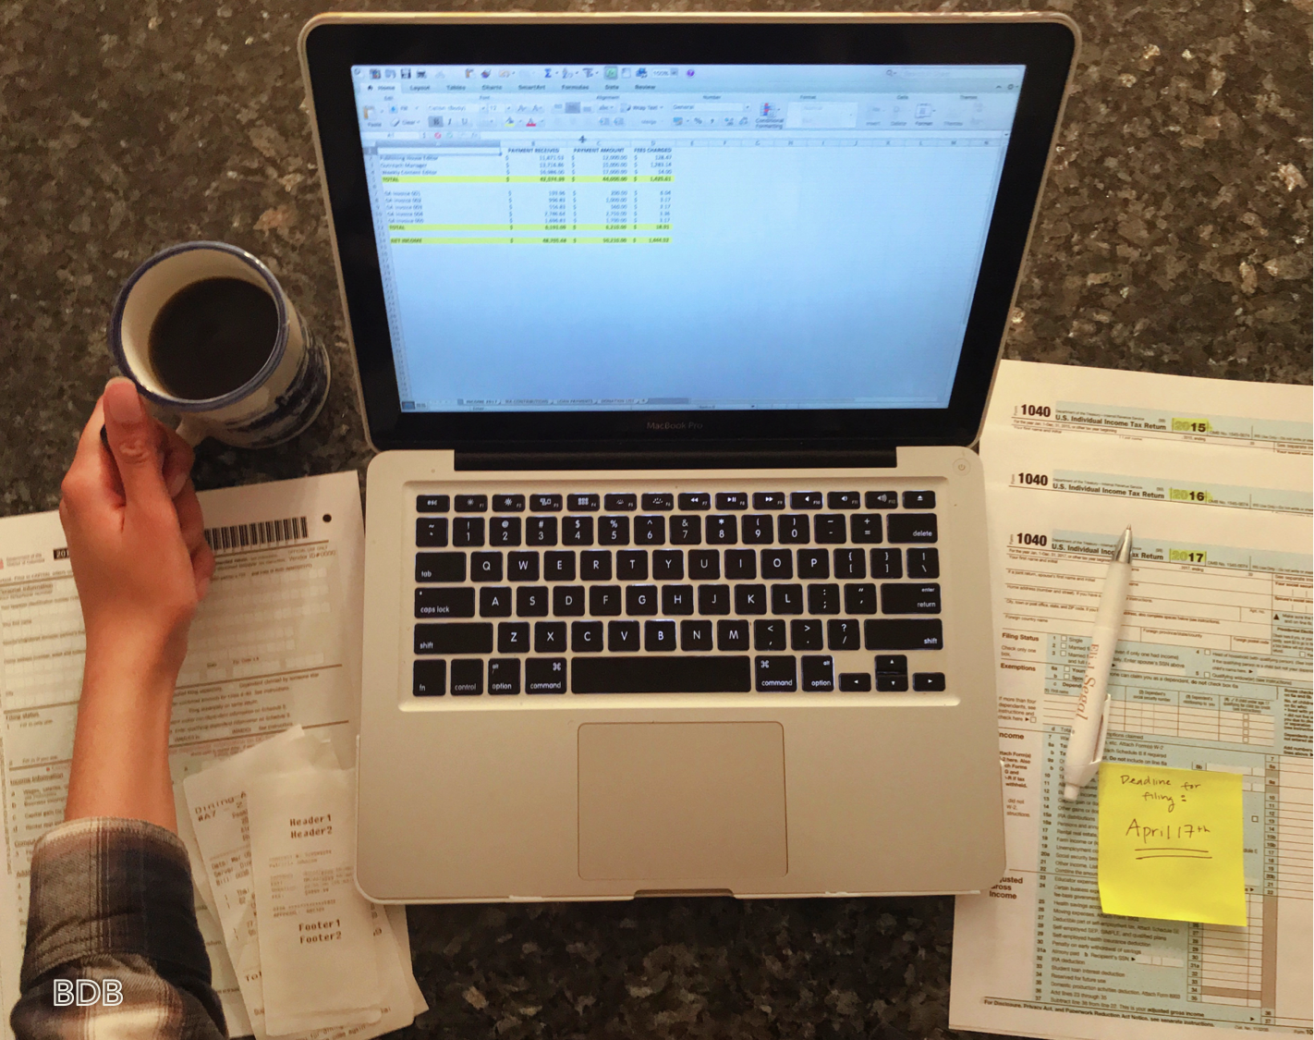
Notes:
Diener and Wallbom (1976). Based on Zimbardo's (1970) theory of deindividuation and Duval and Wicklund's (1972) theory of “objective self-awareness” it was predicted that self-awareness would lead to a decrease in transgressive behavior. Subjects were either made self-aware (seated in front of a mirror listening to their own tape-recorded voice) or nonself-aware (seated to the side of the mirror listening to another's voice) and were given an opportunity to cheat on an anagrams test. Significantly more cheated in the nonself-aware condition (71%) than in the self-aware condition (7%).

Slide 17
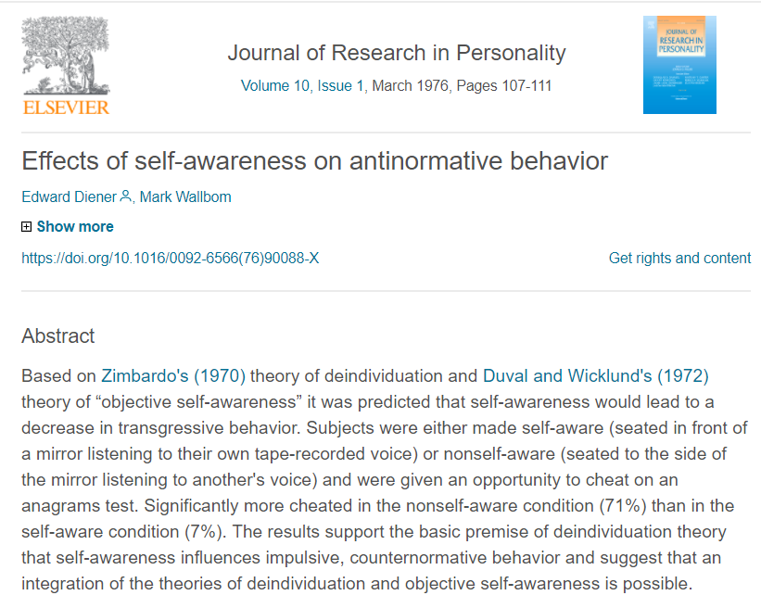
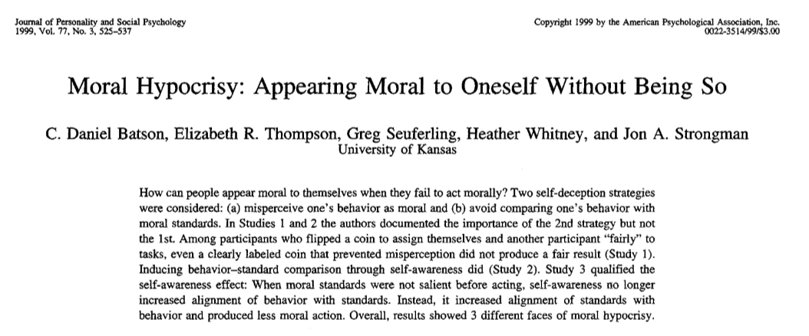

Slide 18
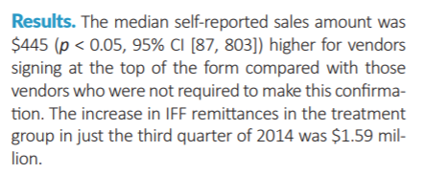
Notes:
https://behavioralpolicy.org/wp-content/uploads/2017/05/BSP_vol1is2_Congdon.pdf
To promote more accurate self-reporting of the sales and, consequently, more accurate payments of the IFF, SBST and GSA introduced a required signature box at the top of an online payment form for a random sample of roughly 18,000 contractors. The signature box asked contractors to confirm the truth and accuracy of the information they were about to report. This intervention is based on research showing that requiring people to sign their names to confirm the accuracy of self-reported statements at the top of a form can reduce self-reporting errors.7 Results demonstrated that the signature box at the top of the form was effective. The median self-reported sales amount was $445 higher for vendors signing at the top of the form compared with those vendors who were not required to make this confirmation. The combined amounts collected totaled $28.6 million from those for whom the confirmation was required, compared with $27.0 million from those for whom it was not. In other words, by introducing the signature box, the federal government collected an additional $1.59 million in fees in a single quarter.

Slide 19
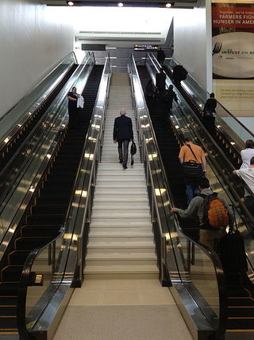
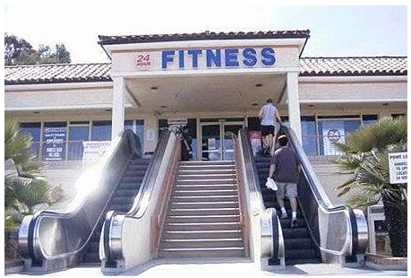

Slide 20
Pinpoint Behaviours to Change During:
Unfreezing:
Willingness to abandon old and adopt new.
Change:
The new is put into place.
Refreezing:
Normalizing the new.
Moving from compliance to commitment.
Kurt Lewin’s 3-Stage Model of Change

Slide 22
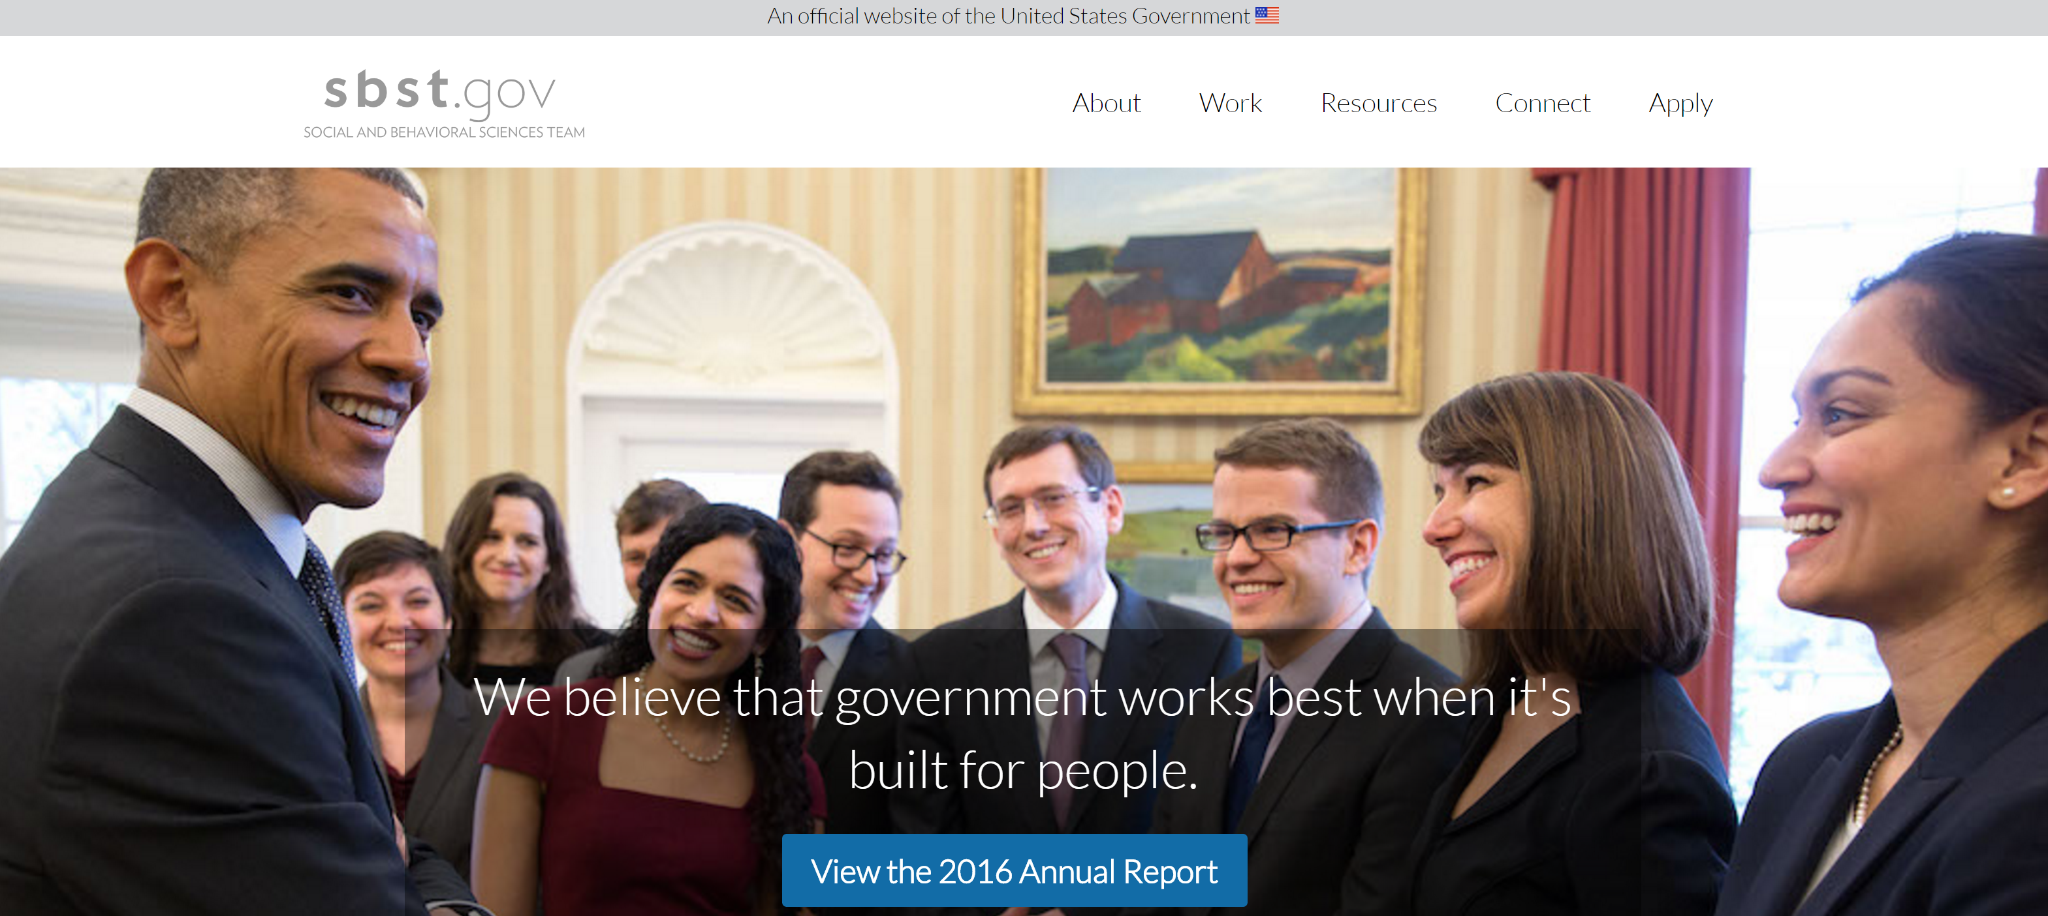
Notes:
https://obamawhitehouse.archives.gov/blog/2015/02/06/west-wing-week-020615-or-all-dreamers

Slide 23
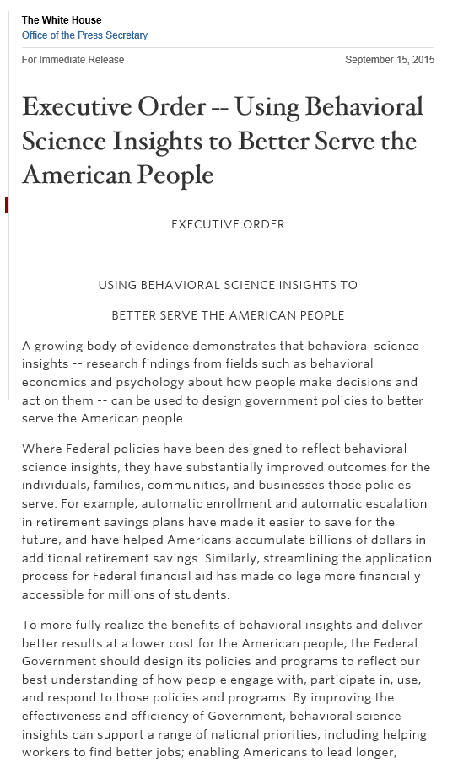
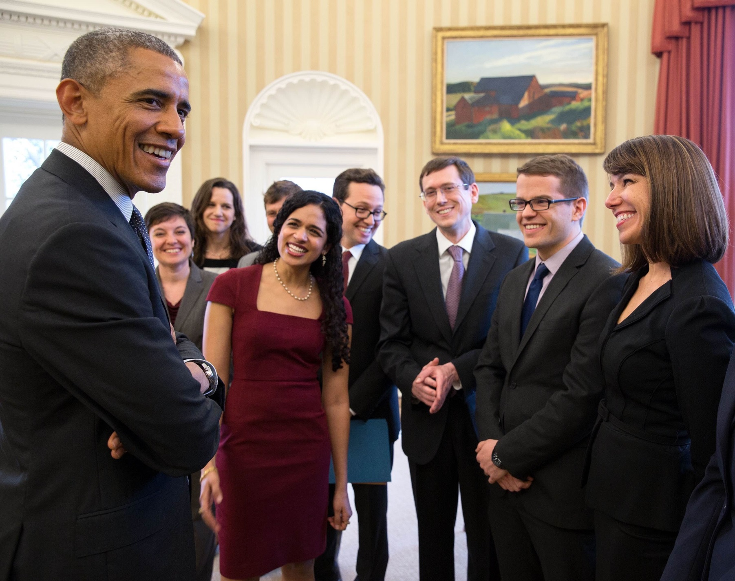
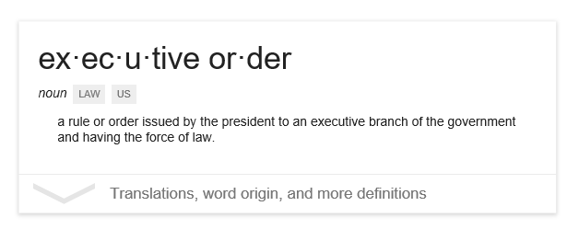

Slide 24
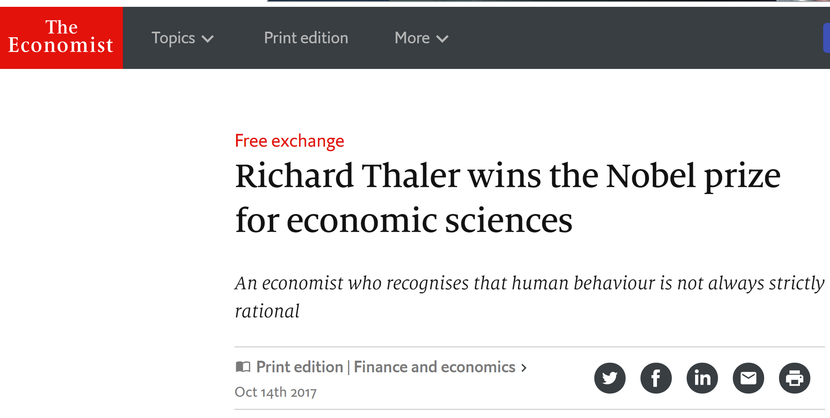

Slide 25
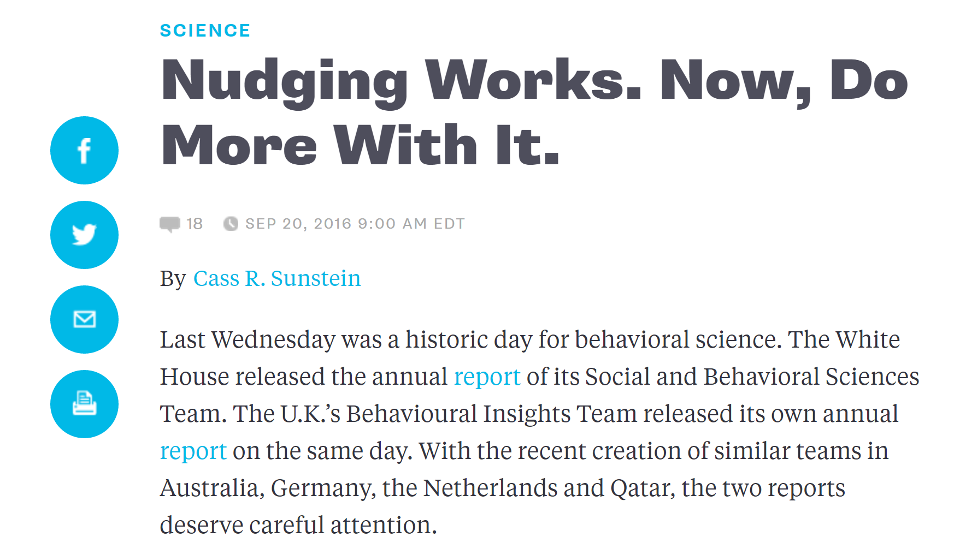

Slide 26
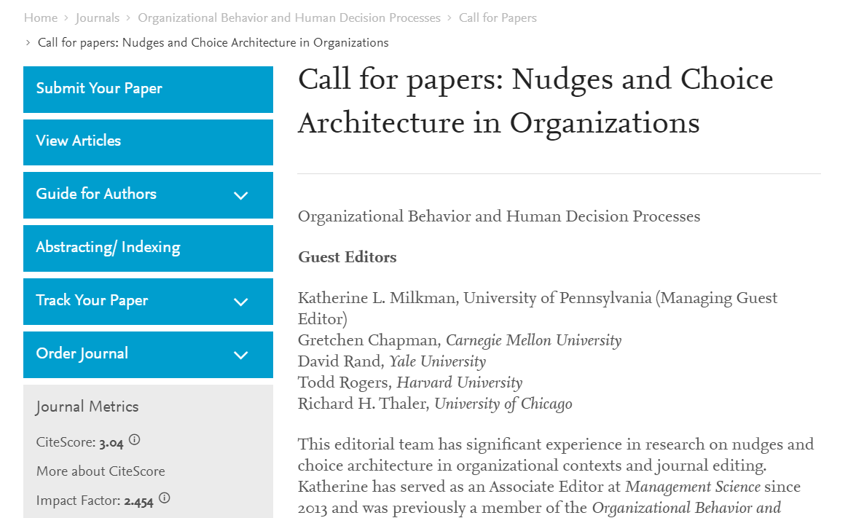
Notes:
https://www.journals.elsevier.com/organizational-behavior-and-human-decision-processes/call-for-papers/call-for-papers-nudges-choice-architecture-organizations

Slide 27
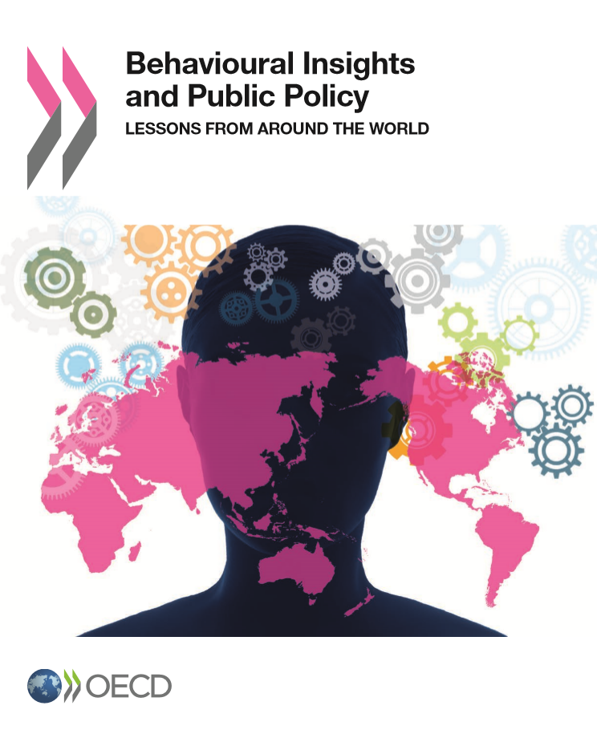
Notes:
https://www.youtube.com/watch?v=DbSsEj4UcJg

Slide 28
Can you nudge whole organizations?
Yes, but …

Slide 29
Behavioral
Economics

Slide 30
I-O Psychology
Behavioral
Economics

Slide 31
Behaviourally Informed Methodology

Slide 32
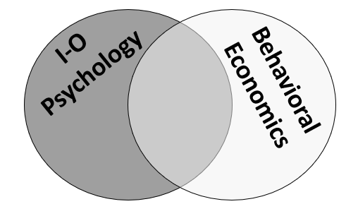
DESIGN
 | Unfreezing | Change | Refreezing
Framing the Reform | X
Leadership | X | X | X
Change Agents | X | X | X
Framing Communication to Staff | X | X | X
Incentives | X | X | X
Building Long-Term Capacity |  |  | X
MEASUREMENT

Slide 33
DESIGN
 | Unfreezing | Change | Refreezing
Framing the Reform | X
Leadership | X | X | X
Change Agents | X | X | X
Framing Communication to Staff | X | X | X
Incentives | X | X | X
Building Long-Term Capacity |  |  | X
MEASUREMENT

Slide 34
What does psychology tell us about work and organizational behaviour?
Rewards can motivate, and backfire.

Slide 35
On the folly of rewarding A, while hoping for B.
Kerr (1995)
Notes:
Steven Kerr
Academy of Management Executive

Slide 36
Learned helplessness.
After repeated punishment or failure, we become passive and remain so even after freed up for success.

Slide 37
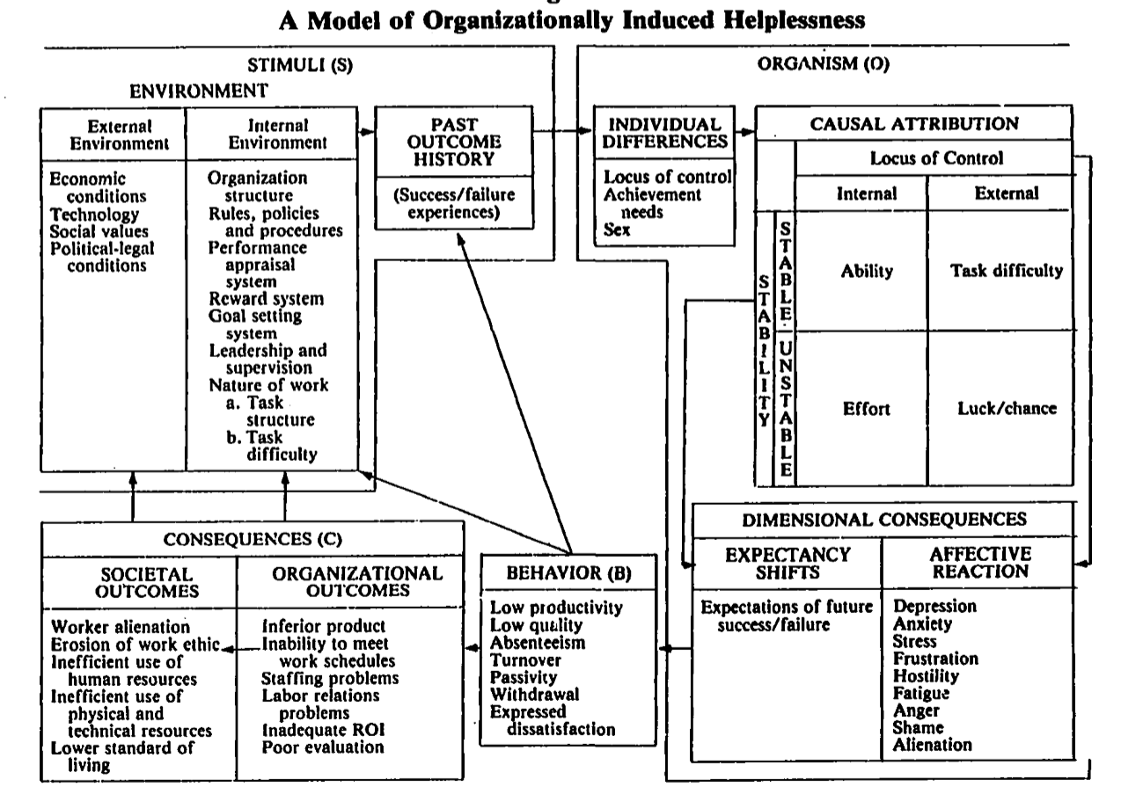
Notes:
Reprinted from Martinko, M. J., & Gardner, W. L. (1982). Learned helplessness: An alternative explanation for performance deficits. Academy of Management Review, 7, 195-204.

Slide 38
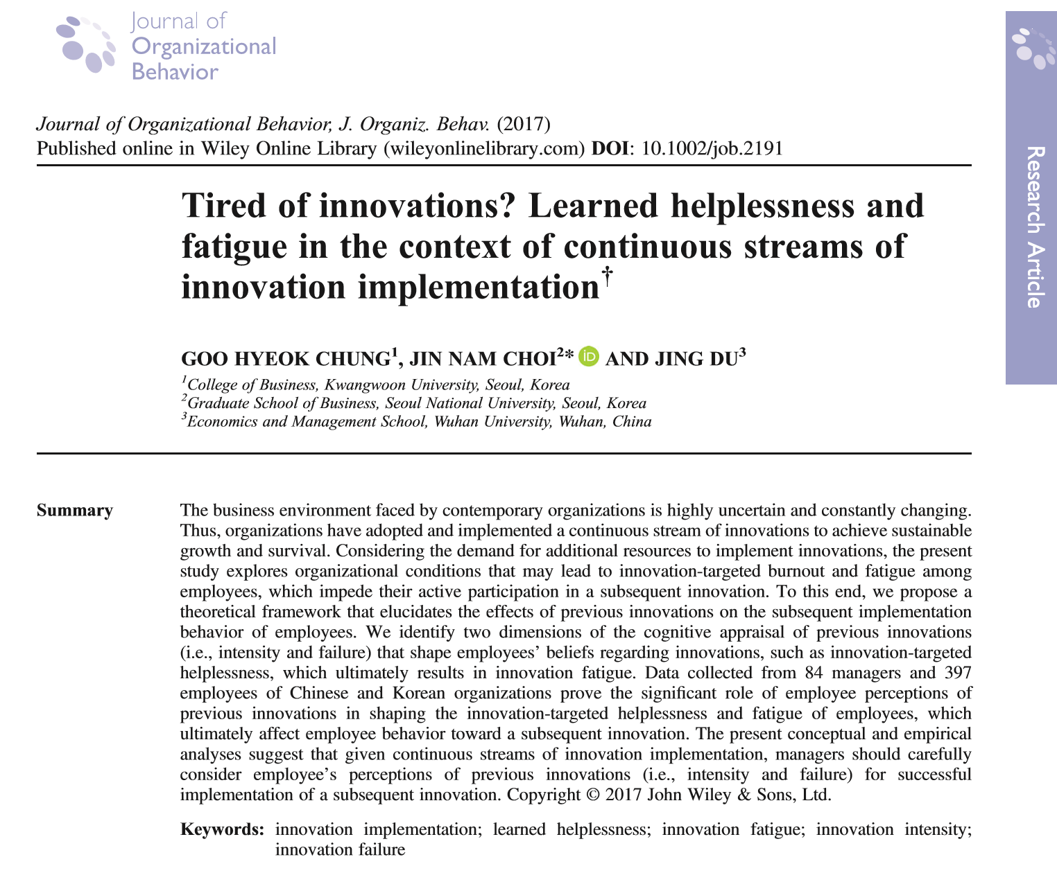

Slide 39
What does psychology tell us about work and organizational behaviour?
There is more to work motivation than monetary rewards and incentives.
Notes:
“It is a central theme of economics that incentives promote effort and performance, and there is a lot of evidence that they often do (e.g., Gibbons (1997), Lazear (2000)). In other words, contingent rewards serve as “positive reinforcers” for the desired behaviour. In psychology, their effect is much more controversial” (Benabou & Tirole, 2003, p. 489). Over the last decade or two, economists and psychologists have begun to develop a more common understanding of work motivation. A 2003 article in the Review of Economics Studies, for example, asserts that rewards may be only weak reinforcers in the short term and may have hidden costs, becoming negative reinforcers once they are withdrawn (Benabou & Tirole, 2003).

Slide 40
Rewards may reinforce in the short term, but may have hidden costs, becoming negative reinforcers once withdrawn. (2003, Review of Economic Studies)
Overjustification effect.
Notes:
“It is a central theme of economics that incentives promote effort and performance, and there is a lot of evidence that they often do (e.g., Gibbons (1997), Lazear (2000)). In other words, contingent rewards serve as “positive reinforcers” for the desired behaviour. In psychology, their effect is much more controversial” (Benabou & Tirole, 2003, p. 489). Over the last decade or two, economists and psychologists have begun to develop a more common understanding of work motivation. A 2003 article in the Review of Economics Studies, for example, asserts that rewards may be only weak reinforcers in the short term and may have hidden costs, becoming negative reinforcers once they are withdrawn (Benabou & Tirole, 2003).
Overjustification effect.
SDT: Extrinsic vs. intrinsic motivation. Autonomy, competence, relatedness.
Ariely and Grant, 2 excerpts.
Job characteristics model.

Slide 41
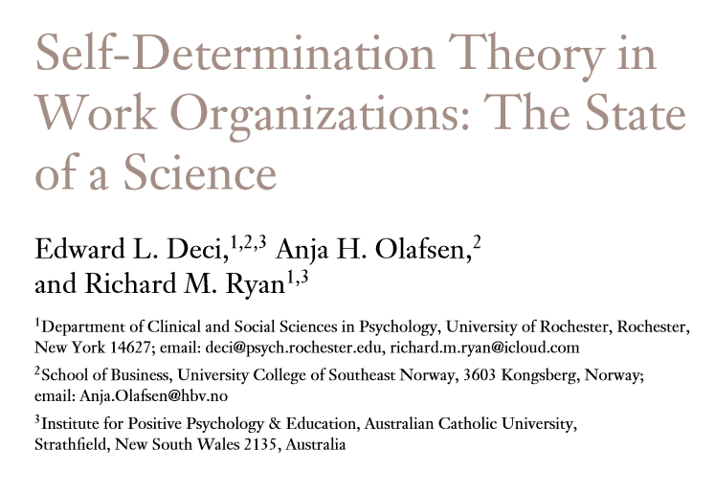
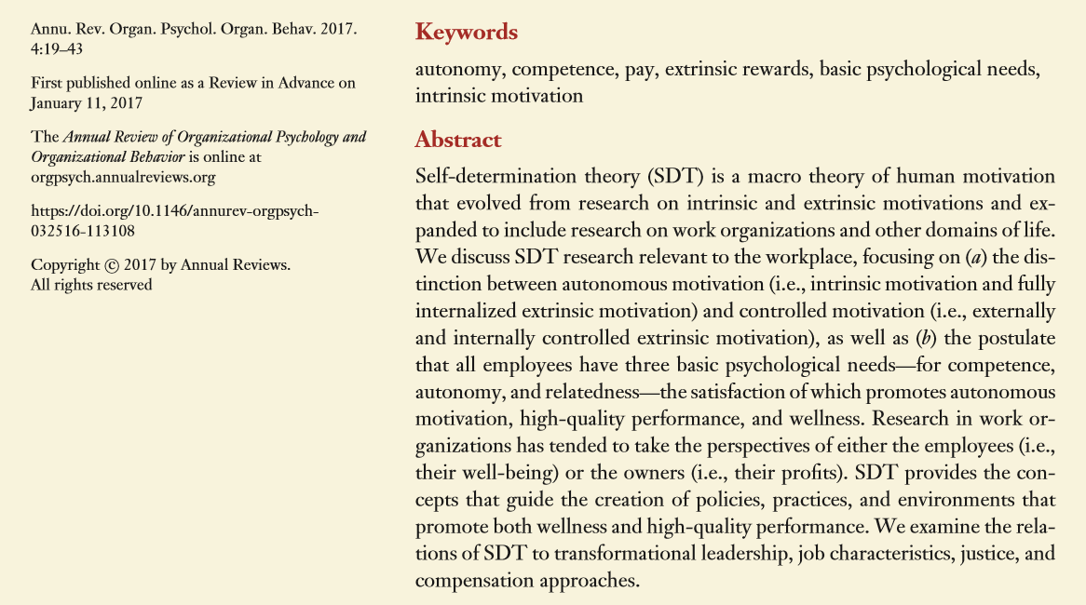

Slide 42
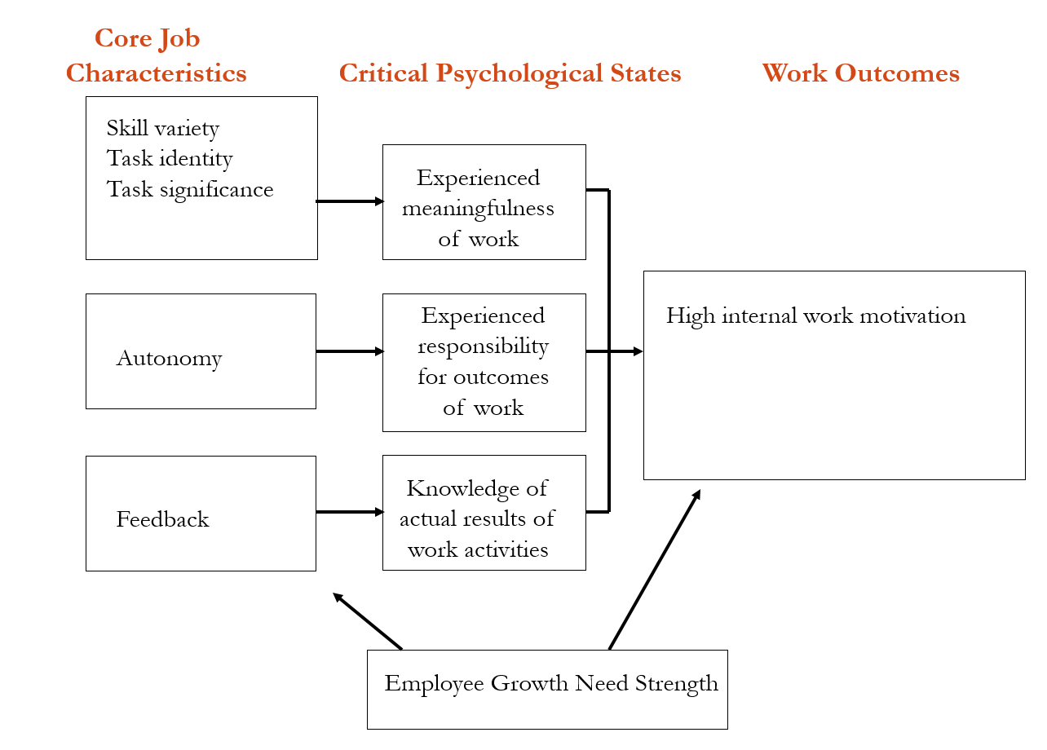
High Internal Work Motivation
High Job Satisfaction
High Performance
Lower Absenteeism
Lower Turnover
Notes:
Hackman and Oldham’s Job Characteristics Model

Slide 43
I-O Psychology
Behavioral
Economics

Slide 44
“In order to succeed, Agenda 2030 must account for behavioural insights research… Our organization, our global agenda – and most importantly the people worldwide they are intended to serve – deserve nothing less than the best science available. A human-centered agenda requires a rigorous, research-based understanding of people.”
--United Nations
Secretary General Ban Ki-moon

Slide 45
Thank you.
Lori Foster
JIU
05 February 2019

